Slide 1

Nitinol SMA Hold-Down Release Mechanism
Team Stellarhold:
Valentin Gamez, Nathan Olson, Maia Warren
Notes:
Planning Notes!
Intro
Client, goal, stakeholders
Problem statement
Requirements
Cr and er
Decision Making
Qfd and most important reqs
Design solution
Generalized design
Prototyping
Design approach
Cad, prototyping
CAD, MFG, and testing processes
Final model, manufacturing process
Budget and expenses
Future work (!!!)

Slide 2
Problem Definition & Requirements

Slide 3
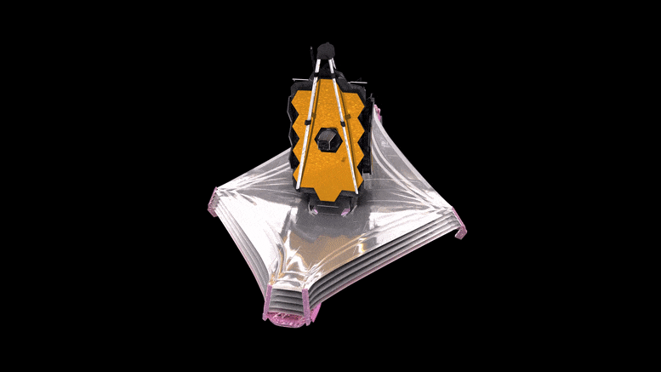
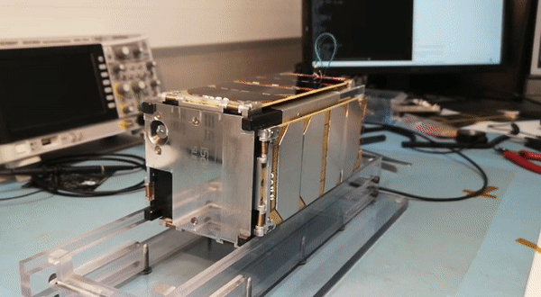
Introduction- What is an HDRM?
Figure 1: JWST Unfolding Example
Figure 2: CubeSat Unfolding Example
Notes:
James webb space telescope for example of why hdrms are important
Cubesat panels deploying for a related use.
Esplain why these are difficult to make (magnetism, pneumatics, hydraulics, electric motors, pyrotechnics)

Slide 4
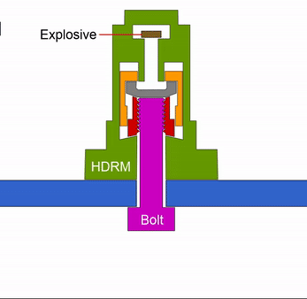
Why Design a New One?
Most designs are not resettable
  Cost per use = Cost per unit for non-resettable
  Why reset?
Explore different actuation techniques
Original client, General Atomics – EMS, wanted an in-house design.
Figure 3: Single-use HDRM

Slide 5
Requirements
Table 1: Customer needs and Engineering Requirements Table
# | CR | ER
1 | No Space Debris | No breakaway parts
2 | Low Outgassing | Low outgassing materials
3 | No Combustion | No combustion
4 | 20x30 cm Deploy Solar Panels | Minimize volume
5 | Minimize Protruding Material | Minimize protruding material
6 | Maximize Deployment Load/ Simultaneously | Maximize deployment force
7 | Easily Resettable | No deformation
8 | Retain Stowed Configuration prior to deployment | Maximize retention reliability
9 | Receive Input Command | Receive input command
10 | Minimize Weight | Minimize weight
11 | Minimize Reset Time | Minimize actuation time
12 |  | Maximize Nitinol life
Notes:
Optimizing volume, weight, reliability. durable, strong, no breakaway parts, extended life.

Slide 6
Design Process & Solution

Slide 7
Decision Process - QFD
 |  | Technical/Engineering Requirement
Customer Needs | Customer Weights | No Breakaway parts | Low outgassing materials | no combustion | minimize volume | minimize external hardware | maximize deployment force | no deformation | maximize retention reliability | must receive input | minimize weight | minimize reset time
No Space Debris | 5 | 1 |  | 1 |  | 1 |  |  | 1 |  |  | 1
low outgassing | 3 |  | 1 |  |  |  |  | 1 | 1
No pyrotechnics | 5 | 1 | 1 | 1 |  |  |  | 1 | 1 |  | 1 | 1
must deploy solar panels 20x30cm | 3 |  |  |  | 1
cannot protrude more than 1cm from bottom | 4 |  |  |  | 1 | 1 |  |  | -1 |  | 1 | -1
Must deploy panels on all sides simultaneously | 3 |  |  |  |  | -1 | 1 |  | 1
Must be able to easily reset | 5 | 1 |  | 1 | -1 |  |  | 1 |  |  |  | 1
Must be able to retained stowed config prior to launch | 5 |  |  |  |  | 1 | 1 |  | 1
must release on command | 3 |  |  |  |  |  |  |  |  | 1
must have rotational abilities | 2 |  |  |  |  |  |  |  | 1
Technical Requirement Units |  | # | % | n/a | CU IN | cm | N | % | % | n/a | g | s
Technical Requirement Targets |  | 0.00 | 0.10 |  | 1.00 | 1 | 25 | 2 | 98.5 |  | 200 | <60
Absolute Technical Importance |  | 15.0 | 8.0 | 15.0 | 2.0 | 11.0 | 8.0 | 13.0 | 19.0 | 3.0 | 9.0 | 11.0
Relative Technical Importance |  | 3 | 2 | 3 | 1 | 2 | 2 | 3 | 5 | 1 | 2 | 2
Figure 4: Annotated QFD
Notes:
High weighted CR’s highlighted yellow
High weighted ER’s highlighted yellow / low weighted ER’s highlighted red

Slide 8
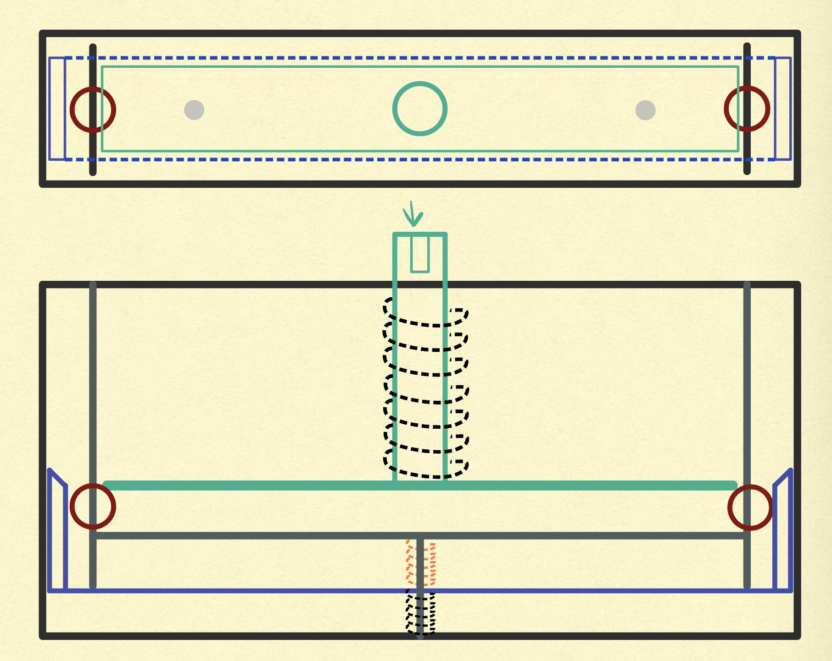
Design Solution
Pin-puller
Manual reset
Nitinol shape memory alloy (SMA) based movement
Locking design (ball bearing)
External power source
Figure 5: Sketch of Design Solution
Notes:
PHOTOS

Slide 9
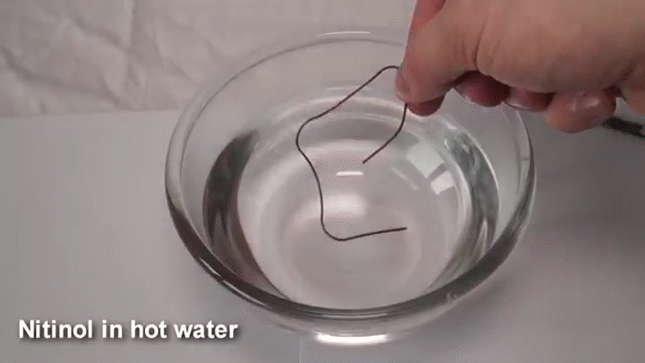
Nitinol – What is It?
Nickel and Titanium based
“Shape Memory” Alloy
Nitinol SMA Example Video

Slide 10
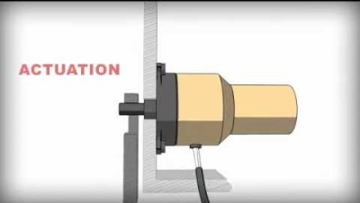
What Does a Pin Puller Do?
How a Pin-Puller Works [1]
Notes:
Video to for context on a pinpuller

Slide 11
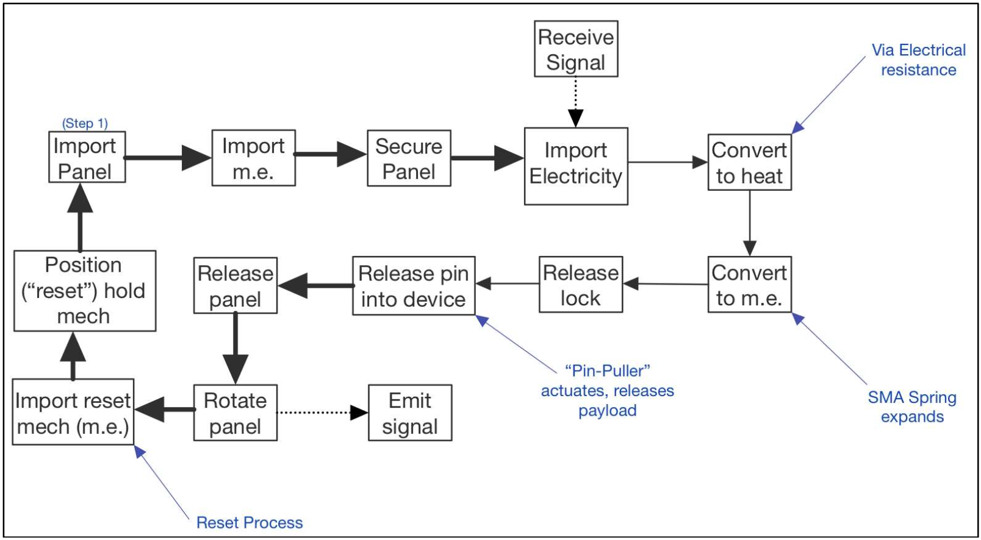
Design Approach – Flow Model
Figure 6: Process Flow Model
Notes:
Show prototyping process pre-final design

Slide 12
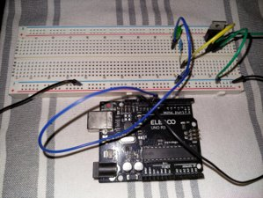
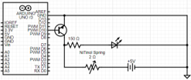
Electrical Components
Figure 7: Pulse Width Modulated Circuit Schematic
Figure 8: Final Circuit Build

Slide 13
Prototyping & Final Designs

Slide 14
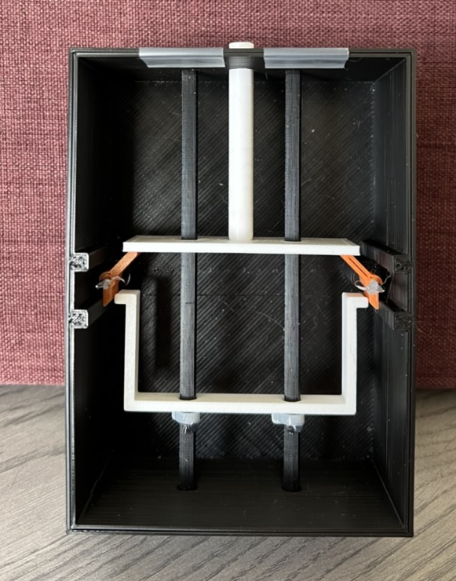
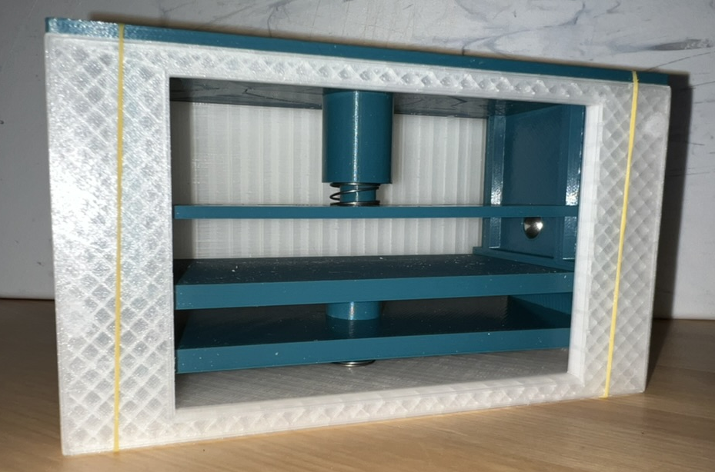
Design Approach – Prototyping
Figure 10: 2nd Prototype
Figure 9: 1st Prototype
Notes:
Show prototyping process pre-final design

Slide 15
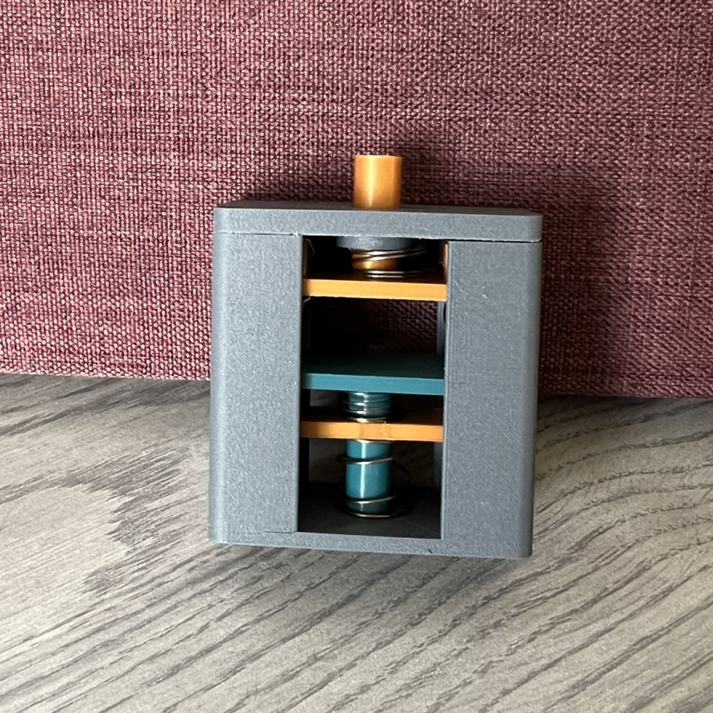
Design Approach – Last Prototype
Figure 11: 3rd Prototype
Notes:
Show prototyping process pre-final design

Slide 16
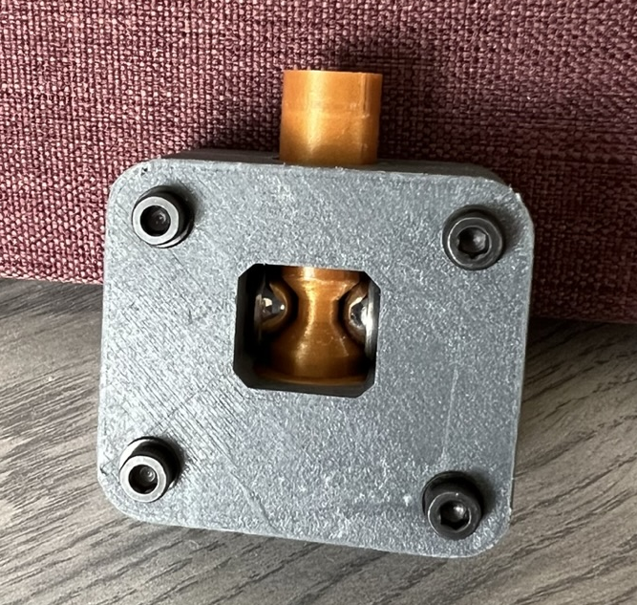
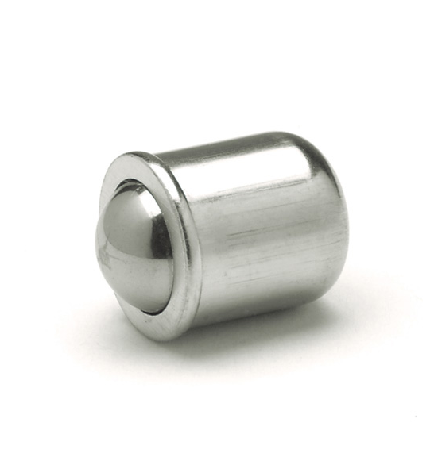
Design Iteration: Alternative Design
Figure 13: Ball Plunger
Figure 12: Alternate Design: Proof of Concept

Slide 17
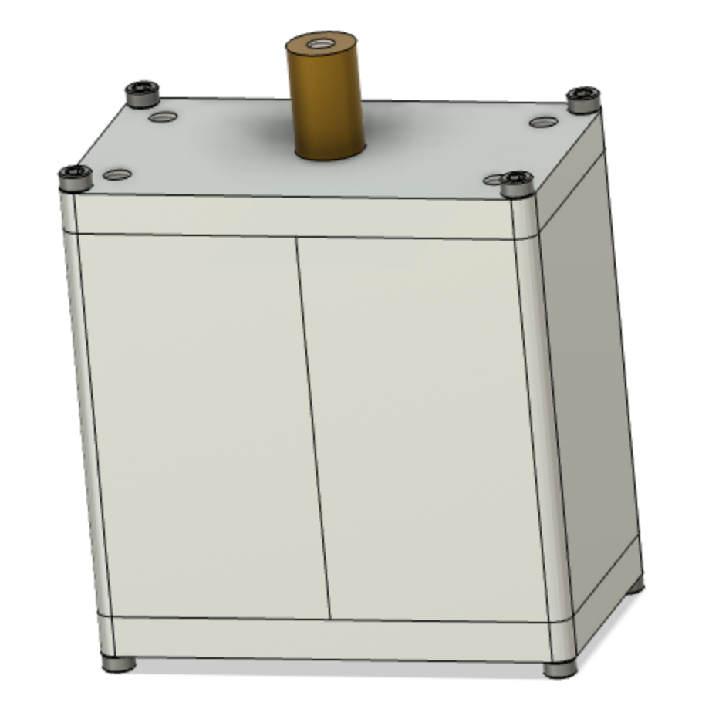
Final Design
Designed for Manufacturing
Off-the-shelf U-channels and rods
Most operations achievable on the manual mill and lathe
Other parts manufactured using 3-d printing and CNC machining
Figure 14: Assembled View of Final Design CAD
Notes:
Add CAD and Animation of CAD for final design only

Slide 18
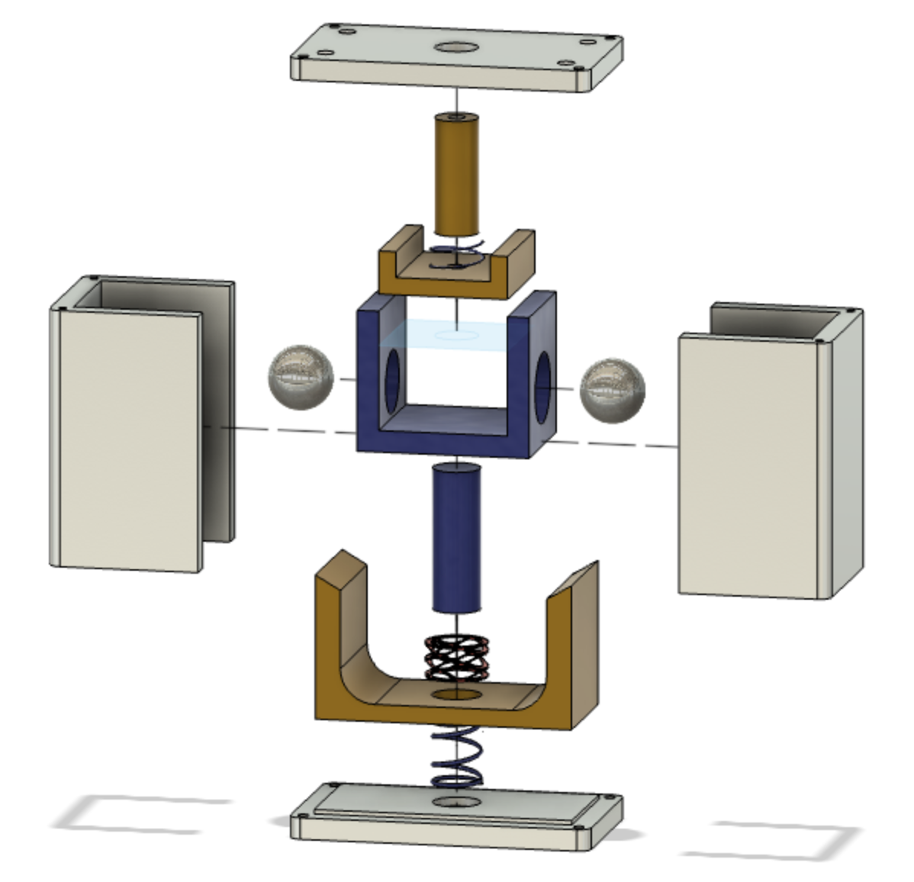
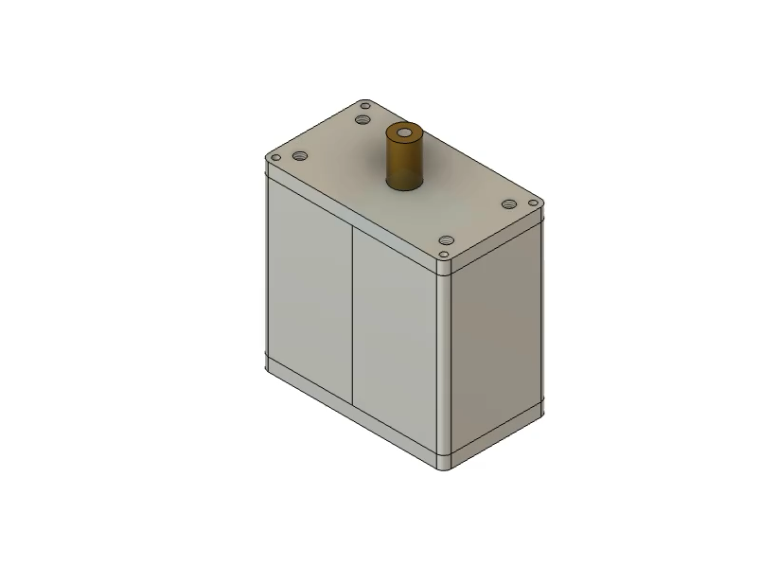
CAD Explosion
Figure 16: Exploded Animation of Assembly
Figure 15: Exploded View of Assembly

Slide 19
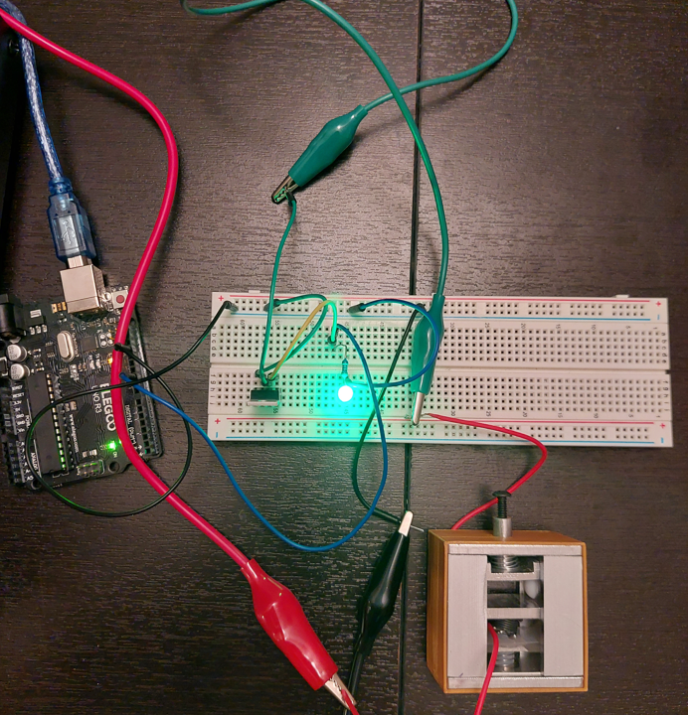
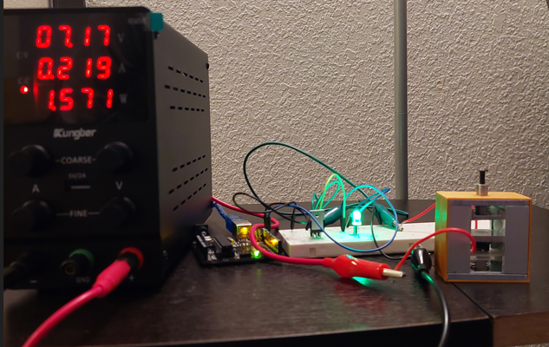
Final Design
Figure 17: Fully Assembled Device (Front View)
Figure 18: Fully Assembled Device (Top View)

Slide 20
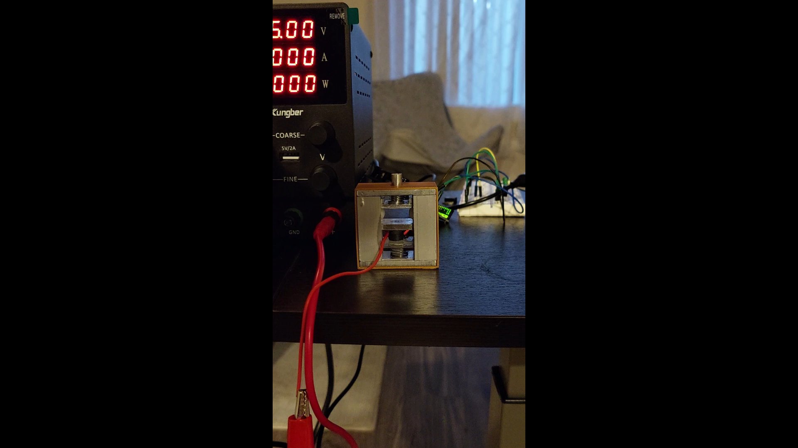
Demonstration

Slide 21
Manufacturing & Speedbumps

Slide 22
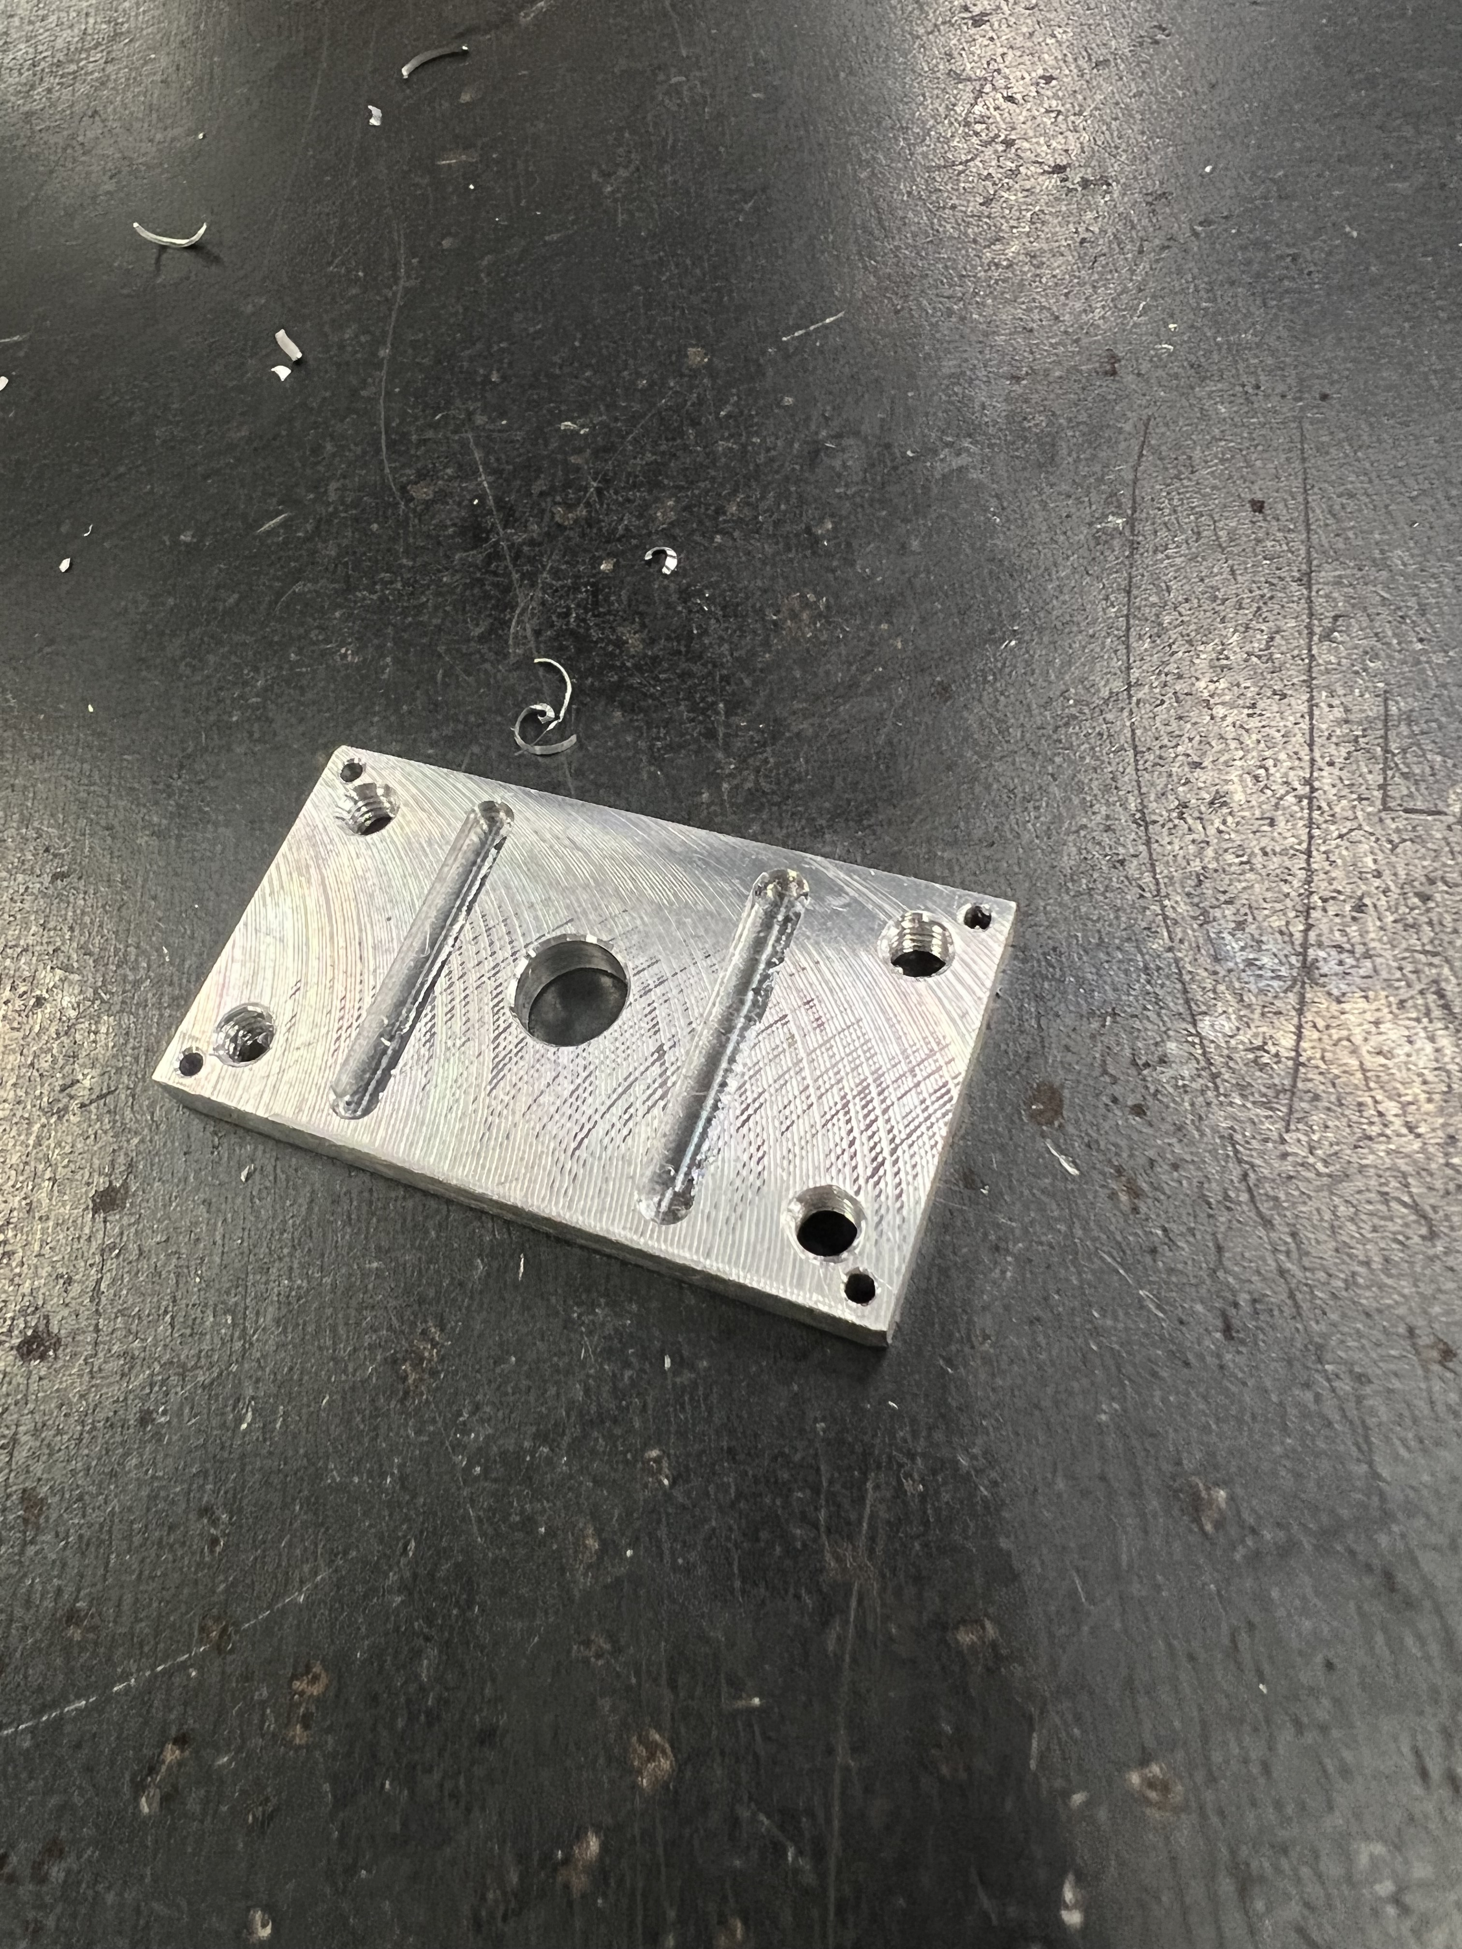
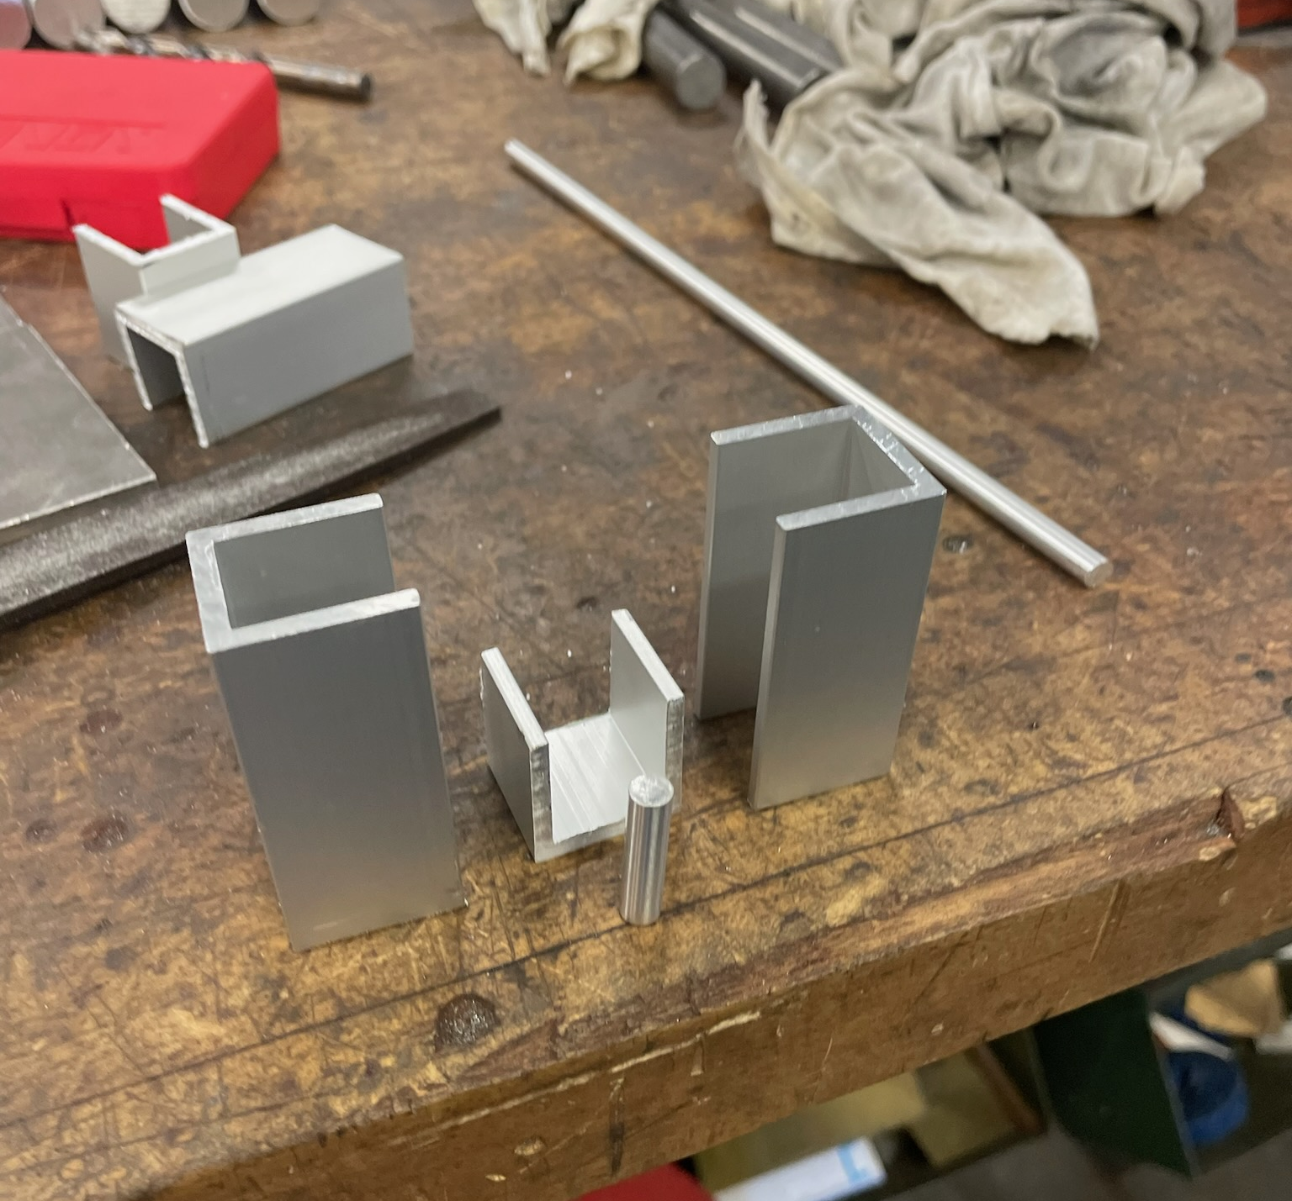
Manufacturing Process – Manual Operations
Figure 19: U-Channels to Cut Down to Size for Enclosure
Figure 20: Top Cap Manufactured on Manual Mill
Notes:
Processes, materials, machines, time, results, struggles
May need to use a second slide for this

Slide 23
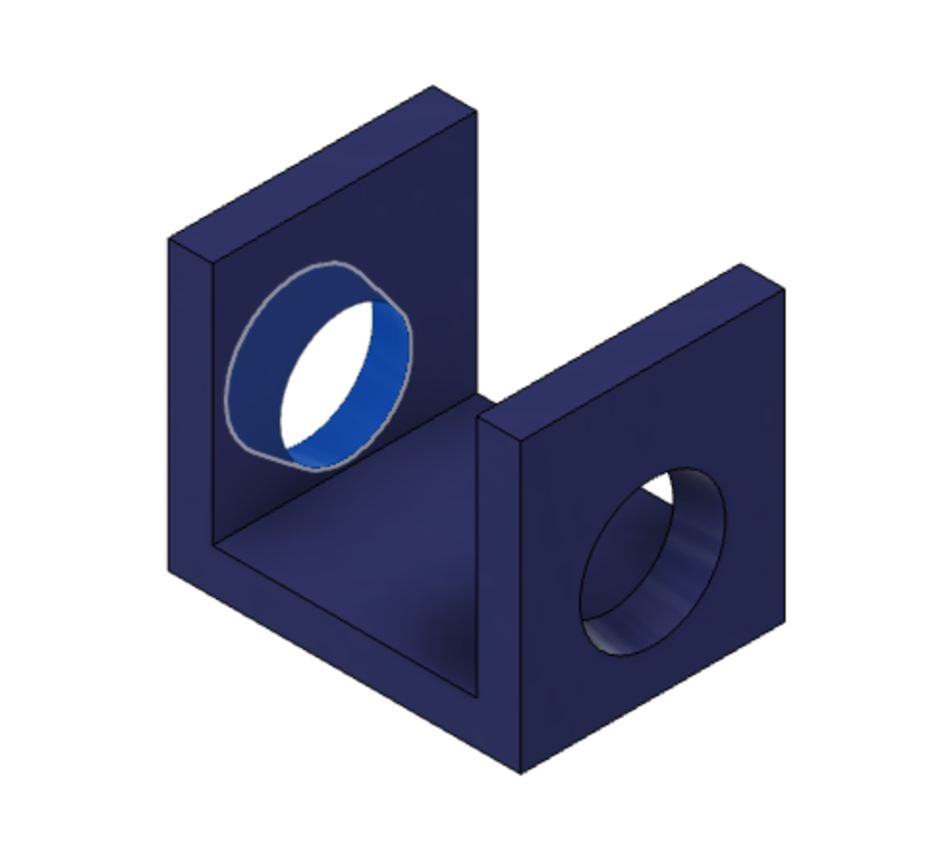
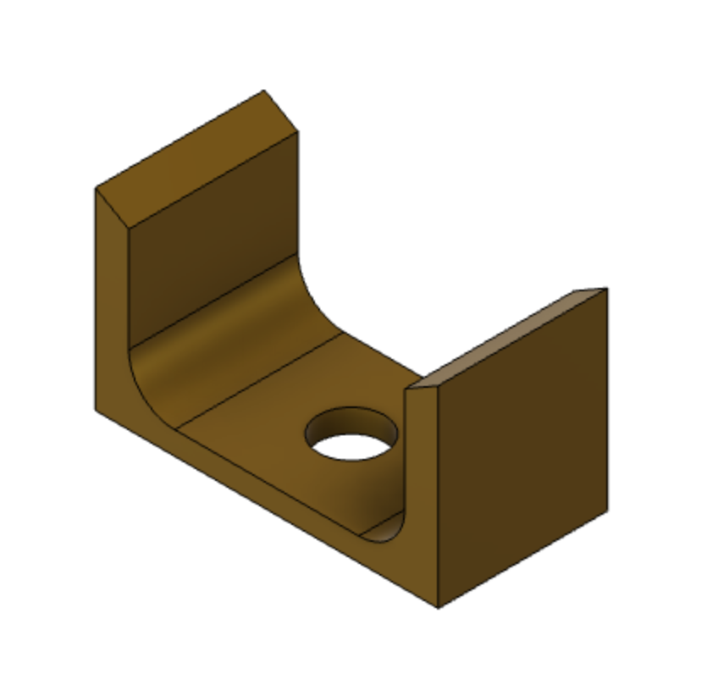
Manufacturing Process – Automated Operations
Figure 21: 3-D Printed for Low Friction
Figure 22: CNC’d Due to Complex Geometry

Slide 24
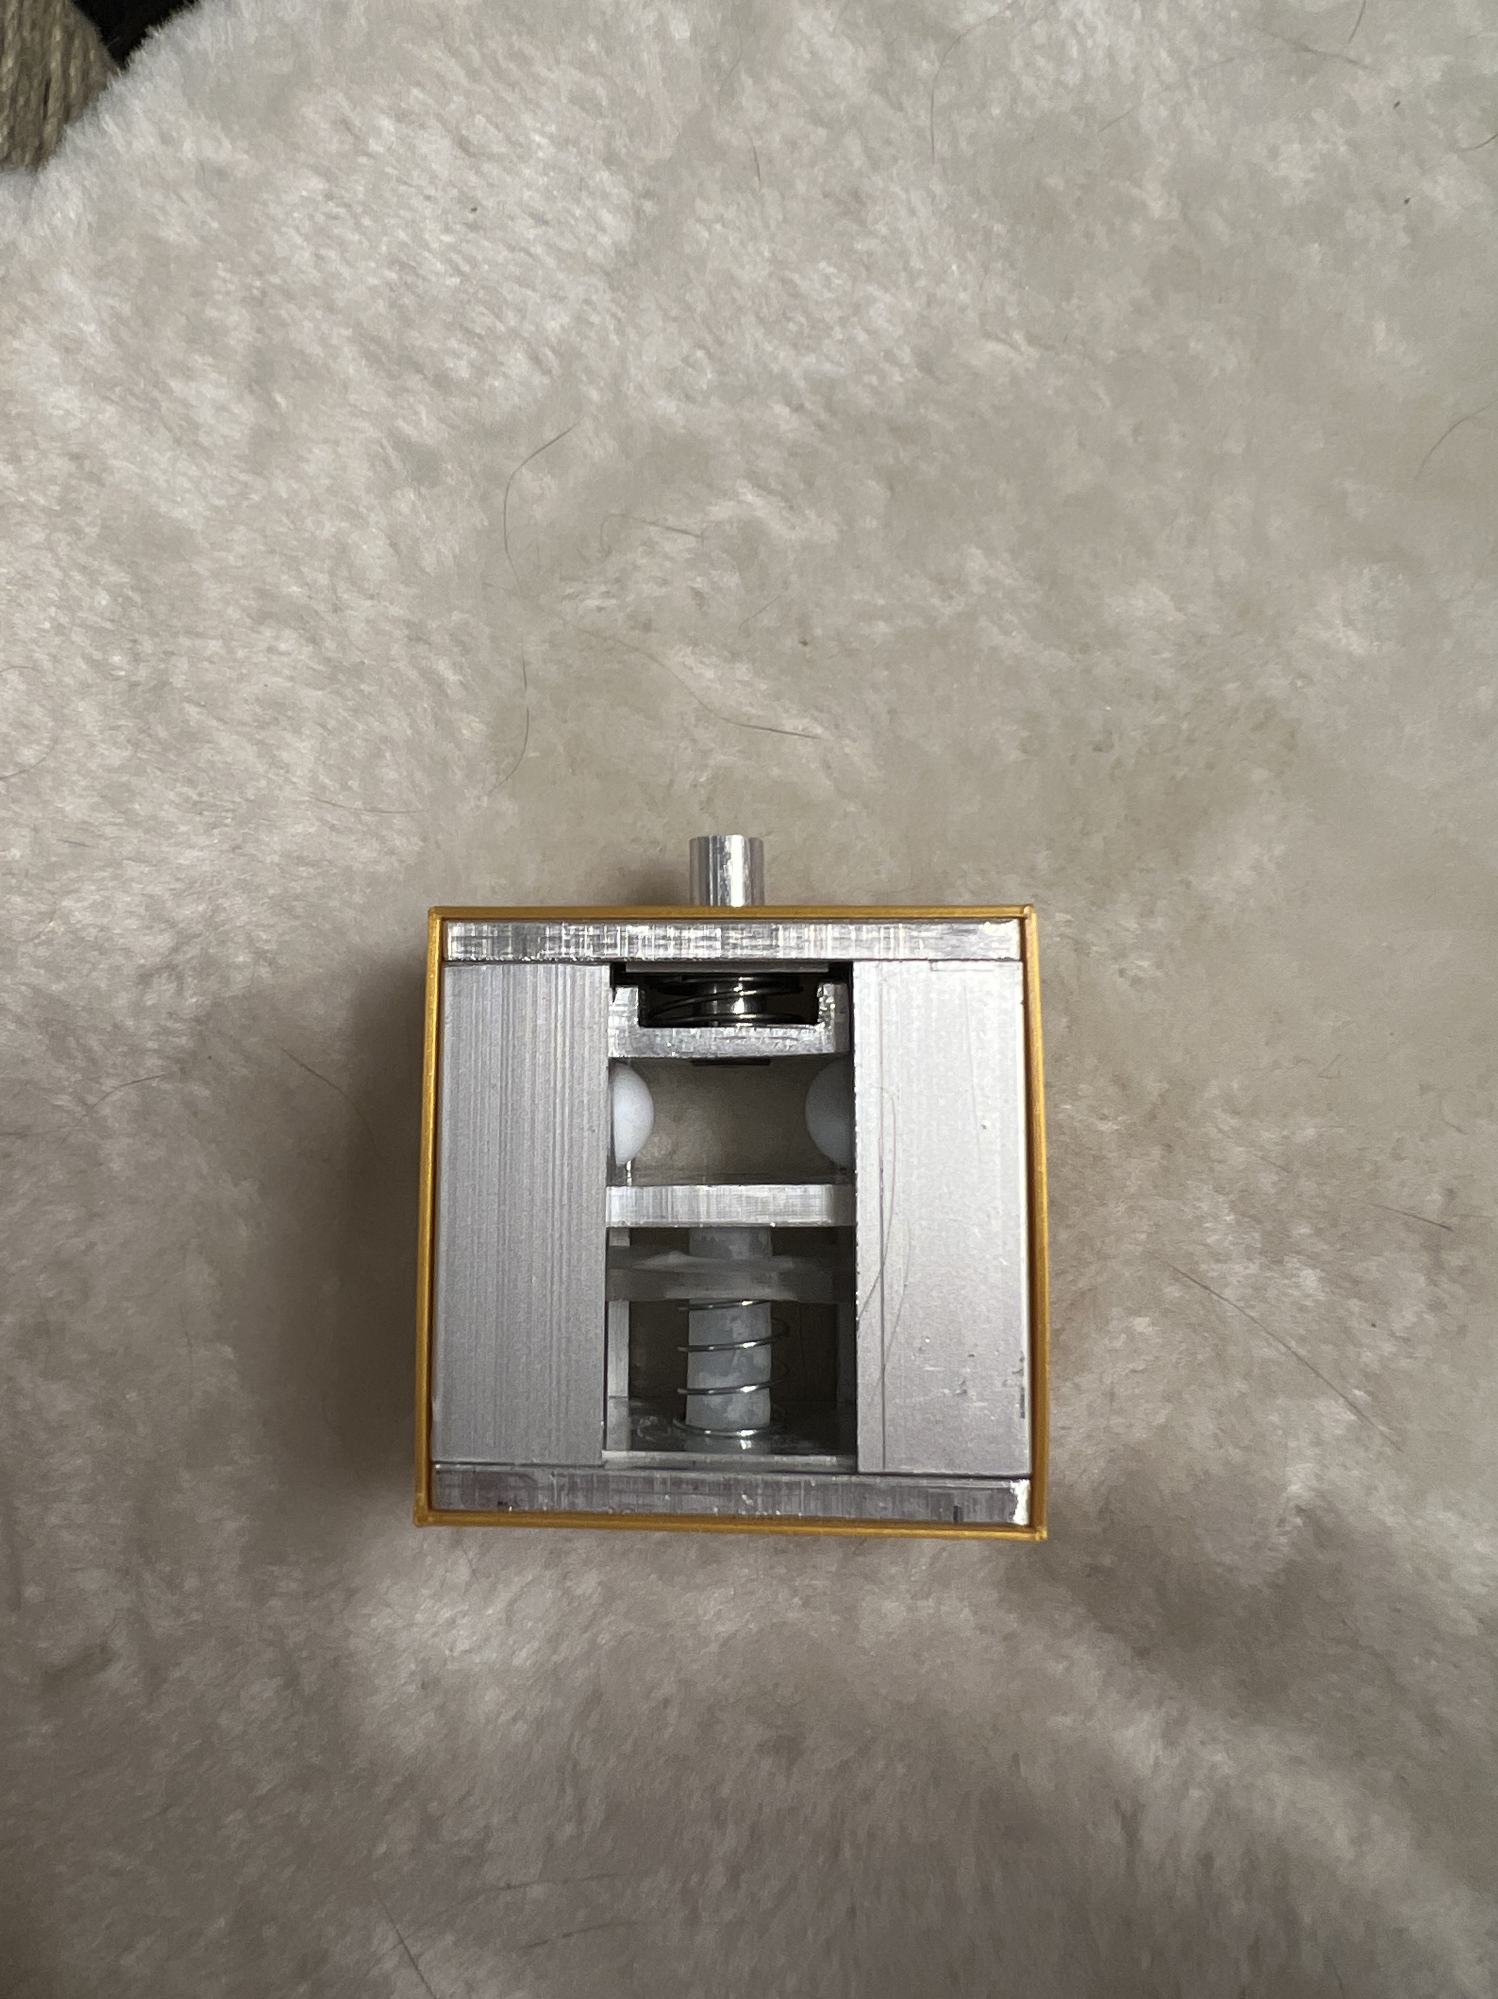
Obstacles & Modifications
Current design required drilling and tapping 8x holes 1.6mm diameter.
Broke two taps & 1 drill bit.
Settled for sleeve and clamping for holding.
Figure 24: Manufactured Model (SMA spring missing) with Sleeve
Figure 23: Original assembly method

Slide 25
Testing

Slide 26
Testing Plan
Table 2: Testing Plan Summary
Table 3: Recap of Requirements
Experiment # | Experiment/ Test | Relevant DRs
1 | Actuation Test | ER9/CR9, ER3/CR3, CR7
2 | Actuation Voltage Test | ER11/CR11
3 | Spring Force | ER9
4 | Shear Load Test | ER7, ER6/CR6
5 | Measurement Verifications | ER5/CR5, ER4
6 | Weight Verifications | ER10/CR10
7 | Outgassing Verifications | ER2/CR2
8 | CubeSat Deployment | CR4, ER6/CR6, CR8
9 | Debris Verification | ER1/ CR1
# | CR | ER
1 | No Space Debris | No breakaway parts
2 | Low Outgassing | Low outgassing materials
3 | No Combustion | No combustion
4 | 20x30 cm Deploy Solar Panels | Minimize volume
5 | Minimize Protruding Material | Minimize protruding material
6 | Maximize Deployment Load/ Simultaneously | Maximize deployment force
7 | Easily Resettable | No deformation
8 | Retain Stowed Configuration prior to deployment | Maximize retention reliability
9 | Receive Input Command | Receive input command
10 | Minimize Weight | Minimize weight
11 | Minimize Reset Time | Minimize actuation time
12 |  | Maximize Nitinol life

Slide 27
Testing (cont’d)
Table 4: Specification Sheet (ERs)
Table 5: Specification Sheet (CRs)
Engineering Requirement​ | Target​ | Units​ | Tolerance​ | Measured/ Calculated Value​ | ER Met? Y/N​ | Client Acceptable? Y/N​
No breakaway parts ​ | 0​ | -​ | 0​ | 0 ​ | Y​ | Y​
Low outgassing materials ​ | 0​ | -​ | 0​ | - ​ | N​ | Y​
No combustion ​ | 0​ | -​ | 0​ | 0​ | Y​ | Y​
Minimize volume ​ | 1​ | cu. In​ | +0.5 ​ | 3.4 in³ ​ | N ​ | Y​
Minimize protruding material ​ | 1​ | cm​ | 0.1​ | 0.1 mm ​ | Y ​ | Y​
Maximize deployment force ​ | 25​ | N​ | - 5​ | 14.5 ​ | N​ | Y​
No deformation ​ | 0​ | %​ | +2 ​ | 0 ​ | Y​ | Y​
Maximize retention reliability ​ | 100​ | %​ | 1.5 ​ | 100 ​ | Y ​ | Y​
Receive input command ​ | -​ | -​ | - ​ | -​ | Y ​ | Y​
Minimize weight ​ | 200​ | g​ | +50 ​ -200​ | 75 ​ | Y ​ | Y​
Minimize reset time ​ | 30​ | sec​ | +30​ | 15​ | Y​ | Y​
Maximize SMA Spring life (1N)​ | 50​ | Cycles​ | 5​ | 20​ | N​ | Y​
Customer Requirements​ | CR Met? Y/N​ | Client Acceptable? Y/N​
No Space Debris​ | Y ​ | Y​
Low Outgassing​ | N​ | Y​
No Combustion​ | Y​ | Y​
Can deploy 20x30cm panels​ | N​ | Y​
Minimize protruding material​ | Y​ | Y​
max deployment load / simultaneously​ | N​ | Y​
Easily resettable​ | Y​ | Y​
Retain stowed config prior to deployment​ | Y​ | Y​
Receive input command​ | Y​ | Y​
Minimize Weight​ | Y​ | Y​
minimize reset time​ | Y​ | Y​

Slide 28
Budget & Future Work

Slide 29
Budget & Expenses
Table 6: Breakdown of Expenses and Purchases – photos omitted for simplicity
Part Description: | Cost: | Quantity: | Date: | Make/ Buy: | Primary Vendor: | Manufacturer:
Acrylic Sheets | 21.83 | 2 | 09/06/22 | Buy | Amazon | Acrylic Mega Store
Nitinol Spring (2.4 mm) | 19.58 | 1 | 02/23/22 | Buy | Amazon | Kellogg’s Research Lab
Aluminum Block | $40.39 | 2 | 09/06/22 | Buy | Amazon | VERNUOS
Generic Springs | $14.18 | 1 | 09/06/22 | Buy | Amazon | Ninoge
Ball-Nose Plunger | $8.38 | 2 | 04/05/22 | Buy | McMaster-Carr | McMaster-Carr
Arduino | $49.12 | 1 | 09/06/22 | Buy | Amazon | Arduino
Aluminum Rod | $30.43 | 1 | 09/06/22 | Buy | McMaster-Carr | McMaster-Carr
U-Channel | $29.55 | 2 | 10/5/22 | Buy | McMaster-Carr | McMaster-Carr
PTFE Balls | $12.28 | 1 | 10/5/22 | Buy | McMaster-Carr | McMaster-Carr
Polyethylene Rod | $5.01 | 1 | 10/5/22 | Buy | McMaster-Carr | McMaster-Carr
Socket Head Screw | $19.81 | 1 | 10/5/22 | Buy | McMaster-Carr | McMaster-Carr
PTFE Film | $24.45 | 1 | 10/5/22 | Buy | McMaster-Carr | McMaster-Carr
Drill Bit | $6.84 | 1 | 10/5/22 | Buy | McMaster-Carr | McMaster-Carr
Compression Spring | $7.24 | 1 | 10/5/22 | Buy | McMaster-Carr | McMaster-Carr
Compression Spring (Short) | $29.28 | 1 | 10/5/22 | Buy | McMaster-Carr | McMaster-Carr
Flat Head Screw | $9.27 | 1 | 10/5/22 | Buy | McMaster-Carr | McMaster-Carr
Load Cell | $10.42 | 2 | 10/5/22 | Buy | Amazon | ALAMSCN
SMA Spring | $20.93 | 2 | 10/5/22 | Buy | Amazon | NexMetal
Standoff “Kit” | $21.83 | 1 | 10/5/22 | Buy | Amazon | VIGRUE
MOSFET Transistor | $10.50 | 1 | 10/31/22 | Buy | Amazon | Bridgold
M1 Bit/Tap | $8.50 | 2 | 10/18/22 | Buy | Amazon | Drill America Store
Power Supply | $62.91 | 1 | 10/18/22 | Buy | Amazon | Kungber
3D Printed Part | $20.02 | 1 | 10/10/22 | Make | NAU | NAU Idea Lab
3D Printed Part | $16.04 | 1 | 10/26/22 | Make | NAU | NAU Idea Lab
Part Total: | $457.38
Total Budget: | $2,000.00
Remaining Budget: | $1,542.62

Slide 30
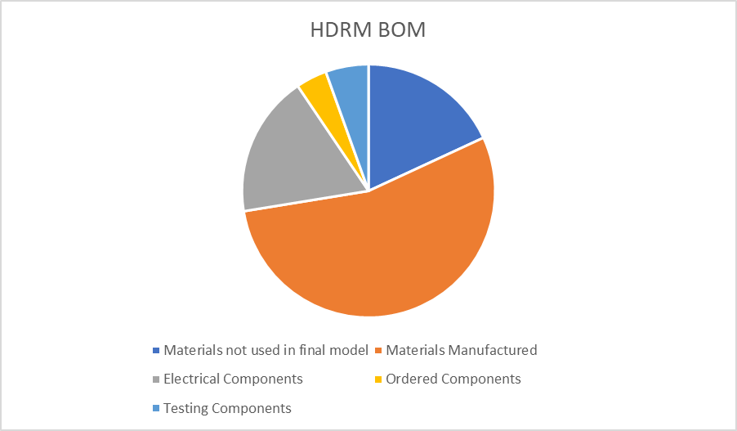
Budget & Expenses Cont'd
Figure 25: Expense Summary

Slide 31
Future Work
Fitting the design into 1 cubic inch using more precise machinery
Using a stronger higher-grade metal that can function under space conditions
Customizing a stronger SMA spring to made the device more reliable and improve functionality of the bias spring
Lower outgassing material to replace the 3D printed part
Utilizing screws (or other method) to hold the design together
Testing actuation under space temperature and turbulence
Certification under NASA’s standards and codes for use in space
Notes:
Huge topic that I believe will be a topic of discussion during questions session

Slide 32
Thank you!
Questions?

Slide 33
References
[1] Ben, “Tini™ Pin puller,” Ensign-Bickford Aerospace & Defense, 05- Jul-2022. [Online]. Available: https://www.ebad.com/tini-pin- puller/. [Accessed: 08-Dec-2022].

Slide 34
Supporting Material

